Slide 1
Starter:
Learned: in this lesson, you will understand what active recall, retention and desirable difficulty are.
Wise: you will know how to revise in a way that helps you truly learn (and memorise) information so that you can effectively retrieve it later.
Think, Pair & Share: Discuss your most and least effective study strategies.
Justify your answer (e.g. I know it works because…)

Slide 2
How to Make Learning Stick
#DREAMBig
Notes:
How to analyse a text
Create a super curricular plan

Slide 3
Chapter 1: Learning is Misunderstood
Task) ‘Popcorn Read’ the chapter called Learning is Misunderstood.
Quick Comprehension Check: What are Comprehension and Retention defined as?
Comprehension: the deep understanding of the underlying principle in order to understand how it applies to different situations.
Retention: to remember the information when a problem or situation calls for it.
Now read the information on the next slide that illustrates an effective example of mental modelling.

Slide 4
Key Principles
Society of saints
Necessary for social change
Crime is inevitable
Strategy: Effective Mind-Mapping
Mind maps are more effective way of recalling information than to reread. Instead, use your PLC to map out the main principles in a topic. Then, map out the key facts/information from these principles. This is a basic example from sociology.
When learning/reading about crime for the first time, map out the top, it’s sub-topics and their key principles and/or facts.
Sub-topic: Functionalism
Topic: Crime
When you come to revise, rather than rereading about ‘crime’, you can ‘remap’ it (literally, creating a new map from scratch) it and see which of the key principles you remember and those you have forgotten. Then go back over those that you don’t remember and add them to your new map. You can then use this as a structure to apply this information to an exam question. Use them together.

Slide 5
Chapter 2: To Learn, Retrieve
Task) ‘Popcorn Read’ the chapter called To Learn, Retrieve
Quick Comprehension Check: Which two principles to maximise the benefits of your retrieval practice?
Effortful retrieval leads to better retention.
Repeated testing improves retention.
Now read the information on the next slide that illustrates an effective examples of Active Recall.

Slide 6
Strategy: Active Recall
Quizzes – use a PLC/Mind Map to create a topic quiz – watch this tutorial on how to get the most out of Quizlet: https://www.loom.com/share/fe3ade34dfe5490a94516e77af34ab8e
Flashcards – sort these into piles of knowledge you know well and those that you don’t know well. Revise the cards you don’t know well until they can be placed in the pile of those you know well.
Self-testing – when you finish a revision session, write 5 quick questions to test yourself on next time you study that topic (with answers).
Mind-mapping (as explained previously).

Slide 7
Strategy: Active Recall
Exam questions – use Revision Guides with answers for instant feedback/self-marking.
Practice problems – in science, maths, applying research methods, applying case studies – practice applying them to a wide variety of knew scenarios e.g. pick a random case, how does tort law apply to it?

Slide 8
Strategy: Active Recall
Past papers (ask for feedback and do this as a timed exercise to practice the real thing!)
Whiteboard recall (read a fact, write it on a mini-white board, try to repeat it, check what you have written is correct, erase it, write it from memory, check it with what is written in the book/notes you started with)
Any type of memory games – this website allows you to create quizzes, match ups and word games https://wordwall.net/

Slide 9
Strategy: Active Recall
Read, Write, Check Repeat (from Dr Wait).
Step 1 – Read a passage/chapter of a book.
Step 2 – Write out the key points.
Step 3 – Close book and hide notes. Write out what you remember (focus on the key points/consider mind mapping this).
Step 4 – Wait a few days. Repeat steps 3 & 4 until you are able to write out all of the key points.

Slide 10
Chapter 3: Mix Up Your Practice
Task) ‘Popcorn Read’ the chapter called Mix Up Your Practice.
Quick Comprehension Check: What two elements would make an effective revision timetable? Why?
Mix up the topics by interleaving and space them out. This allows you to forget and retrieve the information, creating a desirable difficulty, consolidating it in your long term memory.
Then read the information on the next slide that illustrates an effective examples of Interleaving and Spaced Practice.

Slide 11
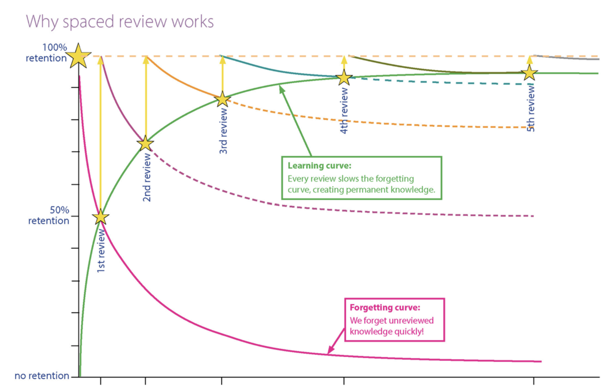
The learning curve and forgetting factor
OCR produced a learning curve & forgetting factor curve to demonstrate the benefits of interleaving practice.
The following slide will explain it in further depth.

Slide 12
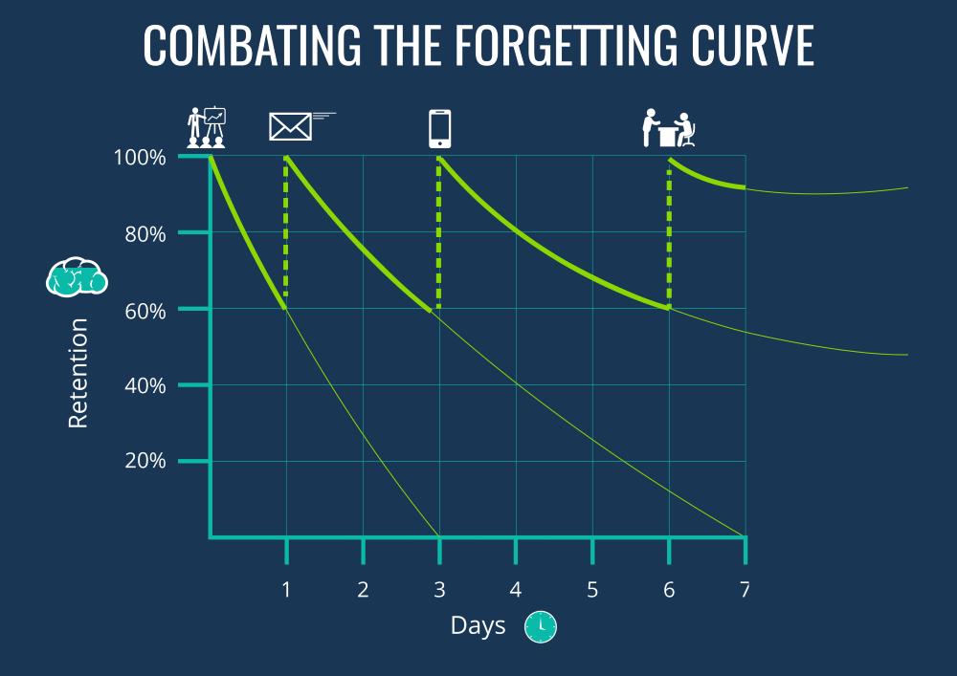
German Psychologist Hermann Ebbinghaus’s Forgetting Curve
Ebbinghaus discovered that information is easier to recall when it’s built upon things you already know.
Every time you reinforce the learning, the rate of decline reduces. The testing effect says that by simply testing a person’s memory, that memory will become stronger.
Staging frequent spaces and revisits to a topic as part of a learning campaign helps solidify the information through active recall.
What is the forgetting curve? Play: https://youtu.be/SCsQHe-NpaM
Spaced Repetition – play: https://www.youtube.com/watch?v=cVf38y07cfk

Slide 13
Applying effective interleaving
Break units down into small chunks and split these over a few days rather than revising one whole topic all at once.
Decide on the key topics you need to learn for each subject.
Create a revision timetable to organise your time and space your learning.
Focus on quality and not quantity- short targeted bursts are more effective.
Do little and often, and mix it up everyday! Variety is, after all, the spice of life!
Learned: in this lesson, you will understand what active recall, retention and desirable difficulty are.
Wise: you will know how to revise in a way that helps you truly learn (and memorise) information so that you can effectively retrieve it later.

Slide 14
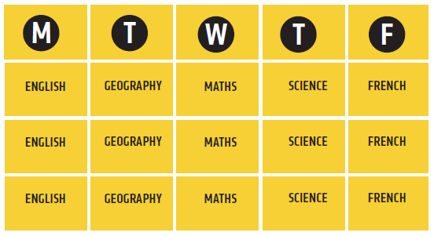
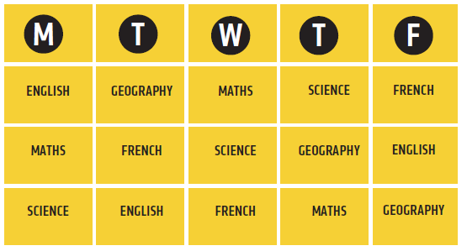
Here is an example if what an interleaved timetable should look like. It seems counterintuitive but the results are immense.

Slide 15
 | Monday | Tuesdayay | Wednesday | Thursday | Friday
Topic 1 | Sociology – family social structure | Media – narrative theory | Spanish – Imperfect tense | Media – gender identity theory
Topic 2 | Media - genre | Sociology – functionalism |  | Sociology – impact of government legislation
Topic 3 | Spanish – preterite tense yo form | Spanish – preterite tense all forms | Sociology – Marxism | Spanish – Imperfect and preterite together
Topic 4
Topic 5 |  |  | Media – representation |  | Sociology – impact of government policies
Here is an example
It is said that the optimum focus of time is one ‘Pomodoro’ (25 minutes with a 5 minute break. You may not wish to shuffle as regularly as every 30 minutes, but certainly don’t study one subject for hours on end!
‘Shuffling’ smaller chunks of revision of bigger topics.

Slide 16
Chapter 4: Avoid Illusions of Knowing
Task) ‘Popcorn Read’ the chapter called Avoid Illusions of Knowing
Quick Comprehension Check: what is one drawback go studying alone?
You are more likely to have misconceptions and not be aware of them. Working in pairs or a group allows others to check your understanding.
Then watch the video on the ‘Feynman’ technique.
https://www.youtube.com/watch?v=tkm0TNFzIeg
The video states to ‘write it down’ to explain it, but it would be better to explain it to a peer who can give you feedback to any misconceptions.

Slide 17
Summary:
Learned: in this lesson, you will understand what active recall, retention and desirable difficulty are.
Wise: you will know how to revise in a way that helps you truly learn (and memorise) information so that you can effectively retrieve it later.
Comprehension is true understanding of the key principles of a topic.
Retention is being able to recall information when a situation requires it.
A strong knowledge base requires memorization of a full mental model of a topic.
To make information stick, retrieve it and make the retrieval effortful.
Repetition of recall and practice makes perfect.
Interleave and space your learning.
Recognising and knowing are two different things – work in pairs of groups to avoid misconceptions.

Slide 18
Task: choose one of the following
Recall – mind map a topic in one of your subjects or create a quiz for one of your topics. Retention – work in pairs or a group (you all have to study the same subject). Choose a topic, mind map it individually and take turns to explain it to your peers. Give feedback. Interleaving – create a spaced and interleaved exam timetable.

Slide 19
Plenary
Learned: in this lesson, you will understand what active recall, retention and desirable difficulty are.
Wise: you will know how to revise in a way that helps you truly learn (and memorise) information so that you can effectively retrieve it later.
Reflection – Think, Pair & Share:
How will your study habits change as a result of interleaving?
How does the theory of interleaving link to the memory?
Imagine you are writing to a current Year 11 student. Write a paragraph that advises them on how best to learn based on what you have learnt in PSHE this term. Include: the Super Curriculum, Cognitive Load Theory, Interleaving and any other personal advice you have.

Slide 20
Feedback
How to use Quizlet effectively e.g. functionalism
Memory games – anything where you can match a name to a concept
Questions at the end of each chapter to check understanding

